Slide 1
Random Statistics Concepts for Data Analysis
(An Uneven Collection of Topics)

Slide 2
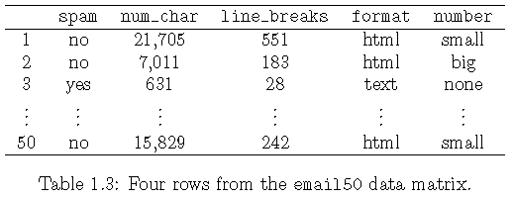
Converting Tables to Stats Terminology
Variables or Characteristics (Columns)
Observation or
Cases (Rows)

Slide 3
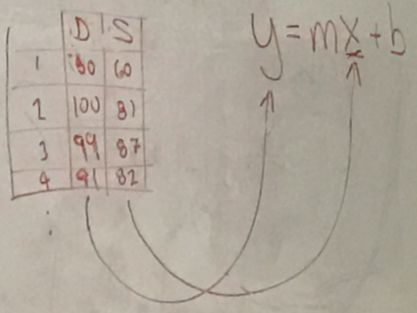
Predictors or
Explanatory Variables or
Dependent Variables
Response Variable or
Dependent Variable
Coefficients:
m = slope = rise/run
b → represents Error

Slide 4
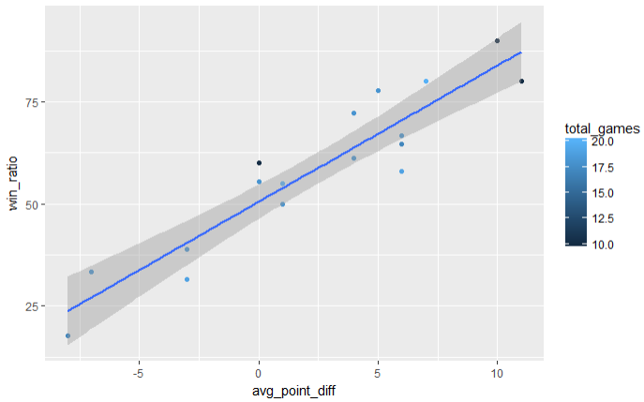
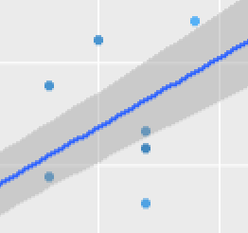
Understanding: Linear Regression Simple Linear Models
Calculating the confidence interval: Mean +/- 1.96 x sqrt(sigma) / sqrt(n)
Where n = sample size
Bootstrapping: adding noise so the model won’t be too perfect and overfit the data

Slide 5
Zooming in on The Previous Image …
Predictors: Points Making Up This Line
Confidence Interval
Residuals: distances from data points to the points on the predictor line of the model (distance from Ydatapoint to Ypredictor.
Data Points

Slide 6

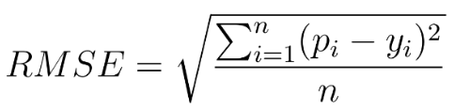


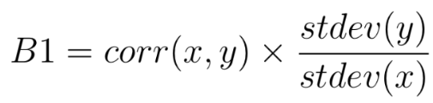
Linear Models: Some of The Underlying Math
Coefficients B0 and B1 in:
B0 = Bias and Y-Intercept
B1 = Slope of the line (linear model)
Calculating B1:
Then use B1 to Calculate B0:
The computer will calculate all of this for you but conceptually it is good to understand this
Some Other Related Calculations:
Root Mean Squared Error:
Linear models seek to minimize this. It also represents how accurate/inaccurate a prediction is expected to be.
To estimate this, use PEARSON() function for “Pearson’s Correlation” expressed mathematically as this:
1 = positive correlation
-1 = negative correlation
Normally, value will be in between to represent how correlated x and y are.

Slide 7

More complex: Linear Models
STOCHASTIC GRADIENT DESCENT:
During each iteration of the gradient descent the computer runs a calculation like this:
w = coefficient or weight to be optimized
alpha = learning rate to configure
delta = error for the model on training data associated to the weight
Multiple iterations are used with the above as input into a mathematical process that ultimately leads to calculation of B0 and B1 for the model.
This can be used with different types of Linear Models
LOGISTIC REGRESSION:
e = base of natural logarithms (Euler’s Number calculated with exp())
B0 and B1 = standard linear coefficients as described on earlier slides
This can be combined with Stochastic Gradient Descent

Slide 8



Linear Disciminant Analysis
PREPARING DATA:
Data needs to resemble Gaussian Distributions for each Variable
Use BoxCox to transform skewed data
Use Log or Root to transform exponential data
Data cleansing includes elimination of outliers
WHAT IT’S FOR:
Can be used to overcome limitations of Logistic Regression
Good for both binary and multiple classification problems using categorical data as input
A LOOK AT SOME OF THE MATH:
Mean value of each input (x) for each class (k):
This is variance across all classes
More complex Bayesian Probability simplified by plugging Gaussian estimates into it yields the discriminant function that underlies LDA:
ln() = natural
logarithm
SPECIFIC EXTENTION VARIANTS ON THIS TECHNIQUE:
Quadratic Discriminant Analysis
Flexible Discriminant Analysis
Regularized Discriminant Analysis
Average Squared difference of each (x) value from the mean:

Slide 9
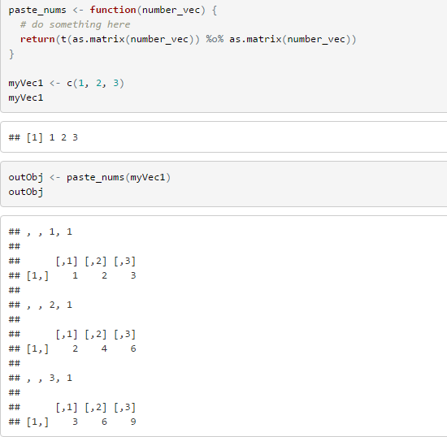
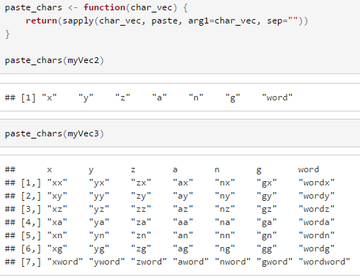
Matrix Math
It is believed that this one is not used as much but we will start with outer product
This R code helps illustrate an outer product
Note that it takes the outer product of a simple vector treated as a matrix and cross-multiplied with itself)

Slide 10
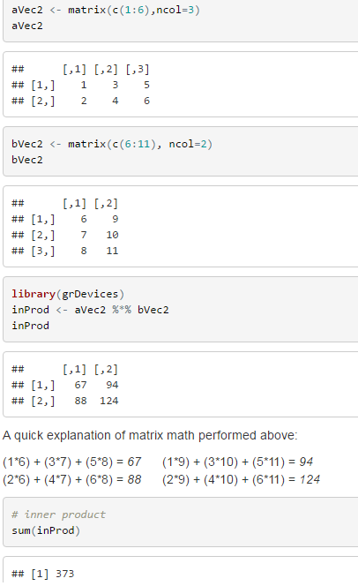
Matrix Math
Inner Products are more common in statistical analysis. In R, `%*%` functions as the operator for inner product calculations.
This code again multiplies two vectors of different dimensions together. As per the name, the “inner dimensions” cancel out and the final vector retains the outer dimension:
dimensions (2 x 3) dot dimensions(3 x 2) = dimensions(2 x 2)
Note: the inner dimensions must match or the inner product cannot be calculated.
In this calculation 2 rows x 3 columns is combined with 3 rows x 2 columns. 3’s cancel and we are left with 2 x 2.
The outers do not have to match. If 3 x 3 were “dotted into” 3 x 2, we would get a matrix of 3 x 2 to sum up for the final answer.
You will hear inner product and “dotting” or “calculating the dot product” used interchangeably for this operation.

Slide 11
More Terms and Concepts
Supervised / Unsupervised Learning:
“Supervised” – there is a response variable to relate to each observation of the predictors which “supervises” the analysis. In short, most of what we think of as standard statistical analysis (or “classical statistical learning methods”) falls into this category and analysis can take the form of linear/logistical regression (classical), and also: GAM, Boosing, SVM (support vector machines) (all listed as more modern approaches)
“Unsupervised Learning” -- No response variable to “Supervise” the results and in some respects is likened to “flying blind”. Descriptions talks about a vector to relate back to x rather than y where y is a response variable. Clustering analysis is an example of unsupervised learning. This can apply to market segmentation.
“semi-supervised learning” – this may be oversimplifying, but this can relate to incomplete data where we have response variables for some but not all and are looking to combine the two techniques to some degree.

Slide 12
More Terms and Concepts
Quantitative / Qualitative (categorical): Typical expectations
Quantitative (numerical) responses are expected in linear regression problems
Qualitative (categorical) responses are expected in categorical problems

Slide 13
More to Come …
More concepts will be explored in these slides as I find the time to add them
This file may get renamed in the future as content evolves into more organized topics

